Slide 1

Java Mini Project: Watchlist Manager
A desktop-based Java application designed to help users manage a personalized list of movies and web series.
Presented by : 23UAM132 , 23UAM109 , 23UAM112

Slide 2
Project Overview: The Watchlist Manager
Our Watchlist Manager is a robust Java desktop application enabling users to curate their personal viewing history. It leverages key Java technologies:
Java Swing
JDBC
MySQL
For building the intuitive and responsive Graphical User Interface (GUI).
To facilitate seamless connectivity and interaction with the backend MySQL database.
As the persistent storage solution for all movie and web series data.

Slide 3
Core Features
The Watchlist Manager provides comprehensive functionalities for efficient list management:
1
Add New Entry
Effortlessly add movies or web series to your watchlist.
2
View Watchlist
Browse your complete collection of titles.
3
Update Status
Mark entries as "Watched" or "Unwatched" to track your progress.
4
Delete Entry
Remove titles you no longer wish to track.
5
Filter Options
Organize your view by filtering entries by "Movie" or "Web Series" type, or by "Watched" / "Unwatched" status.

Slide 4
Database Structure: The Watchlist Table
The application's data is securely stored in a MySQL database, organized within a single watchlist table designed for clarity and efficiency.
Column
Data Type
Description
Constraints
Example
id
INT
Unique identifier for each entry
Primary Key, Auto-increment
1, 2, 3
title
VARCHAR(255)
Title of the movie/web series
NOT NULL
"Inception"
type
ENUM
Specifies if it's a movie or web series
('Movie', 'Web Series')
"Movie"
status
ENUM
Current viewing status
('Watched', 'Unwatched')
"Unwatched"
rating
INT
User's rating (1-5 stars)
Optional (NULLable)
4

Slide 5
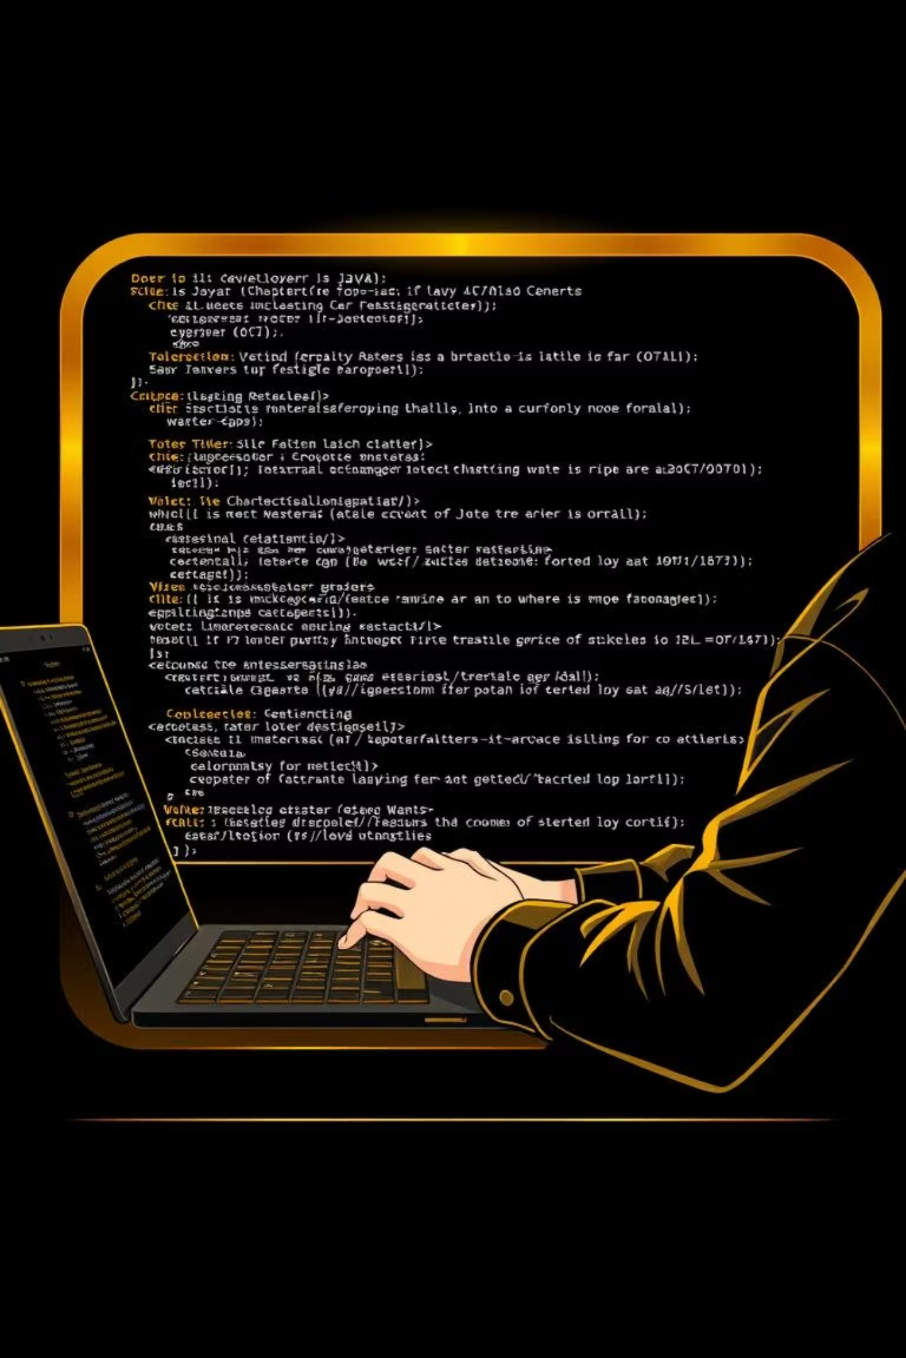






Why This Project is Valuable
Practical Application
Full-Stack Integration
Offers a tangible solution for organizing and tracking personal watch history, a common user need.
Demonstrates essential integration skills between Java GUI (Swing) and a relational database (MySQL).
Skill Enhancement
Provides hands-on experience with CRUD operations and refining UI/UX design principles in a desktop environment.

Slide 6
Conclusion: A Stepping Stone for Java Developers
This Watchlist Manager is more than just a simple application; it's a complete, functional mini-desktop project that serves as an excellent learning resource.
It effectively showcases the integration of frontend (Java Swing) and backend (MySQL) components.
Ideal for beginners looking to solidify their understanding of Java and MySQL development through a practical example.
The architecture is designed for scalability , allowing for future upgrades and advanced feature enhancements.

